Slide 1

Appium ”Studio”
Presented By: February team
Presented To: Dr. Ahmed Sobieh, Eng. Lydia Wahid and CMP 2020
Date: 18/12/2019

Slide 2
What is it ?!
Appium
An open source test automation framework for use with native, hybrid and mobile web apps.
It’s GUI Testing tool.
Appium Studio
An IDE created by Experitest, designed for mobile test automation development and execution, It’s a Wrapper for Appium.

Slide 3
This talk
How Tool Works ?
Tool Components
Test Reports
Running Test Script

Slide 4
How Tool Works
Record ➔ Edit ➔ Execute ➔ Report

Slide 5
Tool Components
Test Area
Test Tool
Command Section
Property/Value section
Log/Code Area
Code Section
Log Section
Devices Area
Application Area

Slide 6
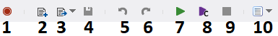
Test Area
Test Tool
Record: start recording test.
New Test: add new Test.
Previous Tests: see your last 7 tests.
Save: save current Test.
Undo.
Redo.
Continue: start test from current state of the program.
Start from the beginning: run the test from the beginning of the program.
Stop: stop test.
Test Report.

Slide 7
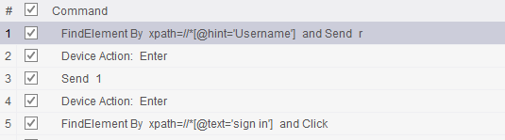
Test Area
Command Section
Find element in the view (textview) with a hint of “username and write in that “r”.
Click enter on the app.
Send “1” in the next field.

Slide 8
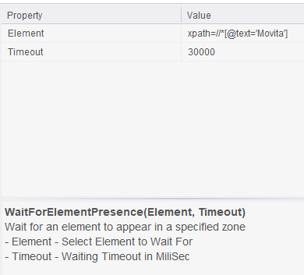
Test Area
Property/Value Section
Each command has a property or
more and a value to it.
xpath => this is a unique identifier
of a view that we want to get inside
the current layout.

Slide 9
Tool Components
Test Area
Test Tool
Command Section
Property/Value section
Log/Code Area
Code Section
Log Section
Devices Area
Application Area

Slide 10
Log/Code Area
The place where you could see the commands as a code in different programming languages and you also see the running process log of a test script.

Slide 11
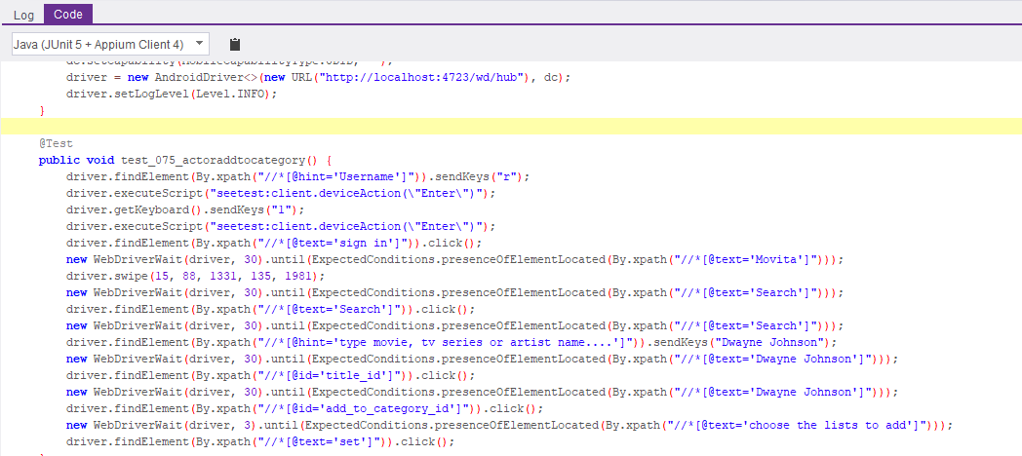
Log/Code Area
Code Section

Slide 12
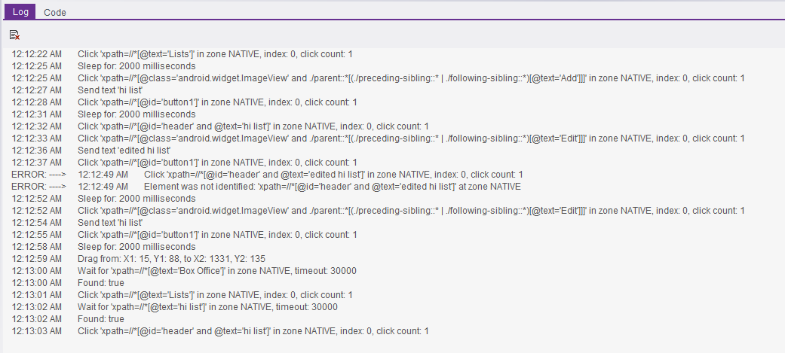
Log/Code Area
Log Section
You can see here all the process of the test script.

Slide 13
Tool Components
Test Area
Test Tool
Command Section
Property/Value section
Log/Code Area
Code Section
Log Section
Devices Area
Application Area

Slide 14
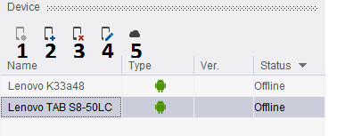
Devices Area

Slide 15
Devices Area
Open device: reflect the screen of your device.
Add new Device: add new mobile to the device area.
Delete a Device: remove a device from the device area.
Edit a device setting: change the resolution and quality of the streaming.
Get a mobile from the cloud: this feature has been stopped.

Slide 16
Tool Components
Test Area
Test Tool
Command Section
Property/Value section
Log/Code Area
Code Section
Log Section
Devices Area
Application Area

Slide 17
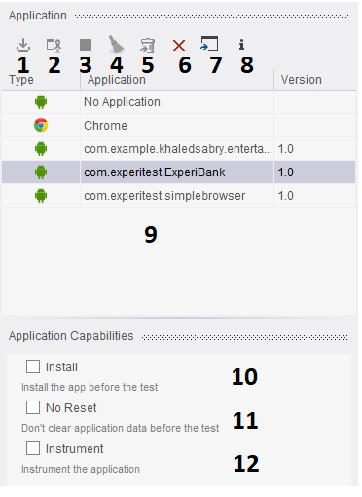
Application Area
Install the app on Appium.
Launch the app on the device.
Close the App.
Clear the Data of the app on the device.
Uninstall the App.
Delete the App.
Import the app to Appium.
Info about the App.
Apps installed on Appium.
Install: install the app before the test
No Reset: don’t clear application data before the test
Instrument: instrument the application

Slide 18
This talk
How Tool Works ?
Tool Components
Test Reports
Running Test Script

Slide 19
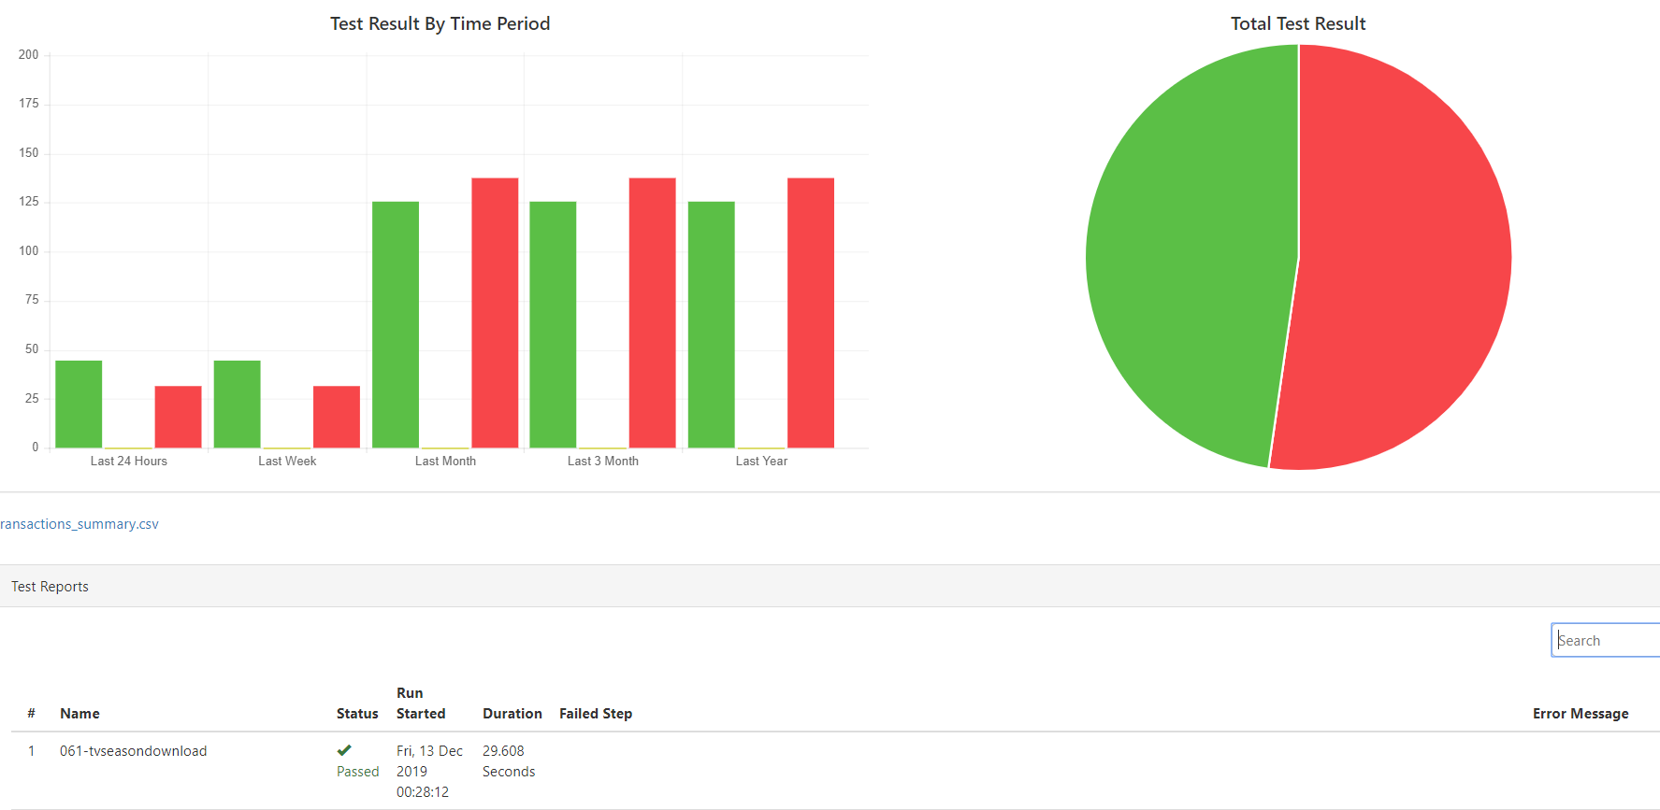
Test Reports
Tests Report Summary

Slide 20
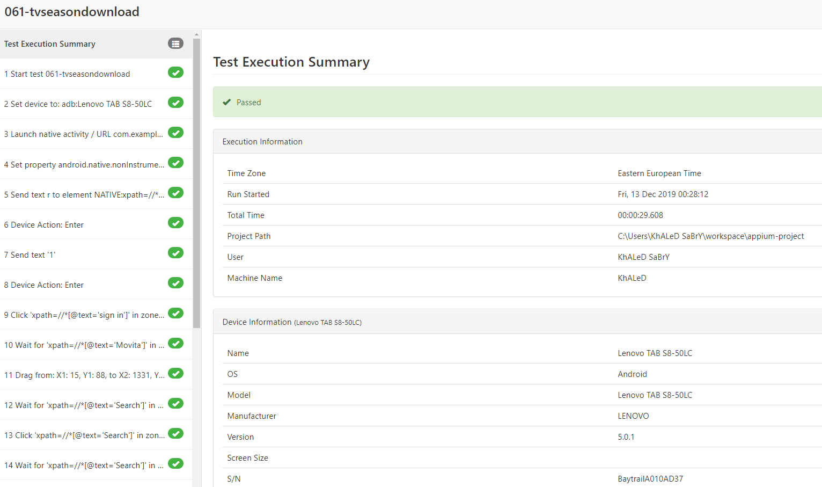
Test Reports
Test Execution Summary

Slide 21
This talk
How Tool Works ?
Tool Components
Test Reports
Running Test Script

Slide 22
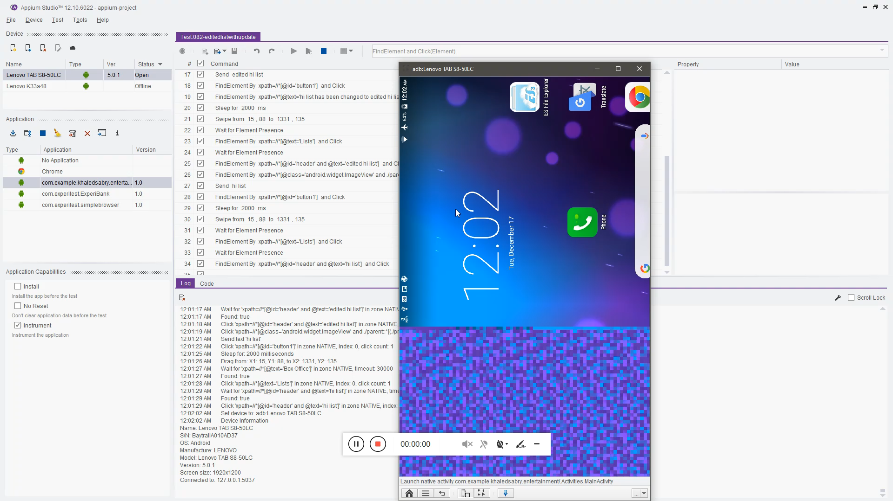
Running Test Script

Slide 23
Any Questions ?

